Slide 1
Cooking Fire Safety Awareness
Cooking is the leading cause of home fires and home fire injuries
For more Emergency Response information visit
Courtesy of the United States Fire Administration

Slide 2
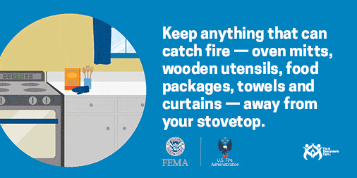
Cooking Fire Safety Awareness
Cooking is the leading cause of home fires and home fire injuries
Typically, fires are not accidents…
…They’re Preventable
Typically, fires are not accidents…
…They’re Preventable
For more Emergency Response information visit
Courtesy of the United States Fire Administration

Slide 3
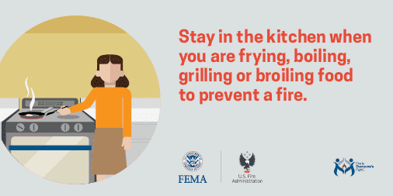
Cooking Fire Safety Awareness
Cooking is the leading cause of home fires and home fire injuries
For more Emergency Response information visit
Courtesy of the United States Fire Administration

Slide 4
Cooking Fire Safety Awareness
Cooking is the leading cause of home fires and home fire injuries
For more Emergency Response information visit
Courtesy of the United States Fire Administration

Slide 5
Cooking Fire Safety Awareness
Cooking is the leading cause of home fires and home fire injuries
For more Emergency Response information visit
Courtesy of the United States Fire Administration

Slide 6
Cooking Fire Safety Awareness
Cooking is the leading cause of home fires and home fire injuries
For more Emergency Response information visit
Courtesy of the United States Fire Administration

Slide 7
Cooking Fire Safety Awareness
Cooking is the leading cause of home fires and home fire injuries
For more Emergency Response information visit
Courtesy of the United States Fire Administration

Slide 8
Cooking Fire Safety Awareness
Cooking is the leading cause of home fires and home fire injuries
For more Emergency Response information visit
Courtesy of the United States Fire Administration

