Slide 1
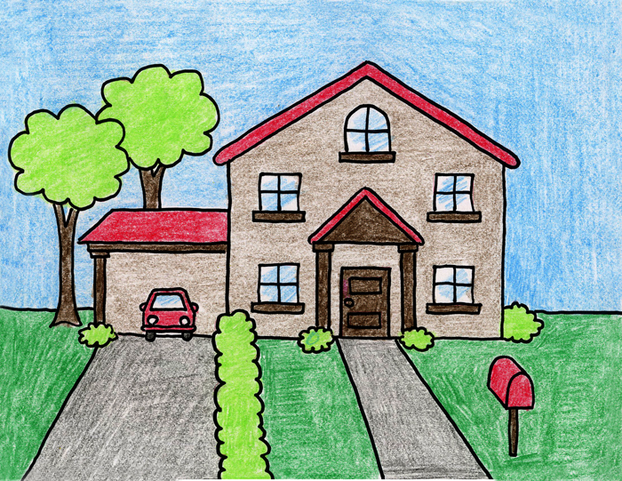

Home/Apartment Fire Safety Team Huddle

Slide 2
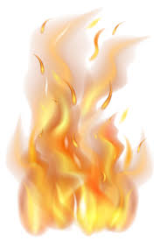
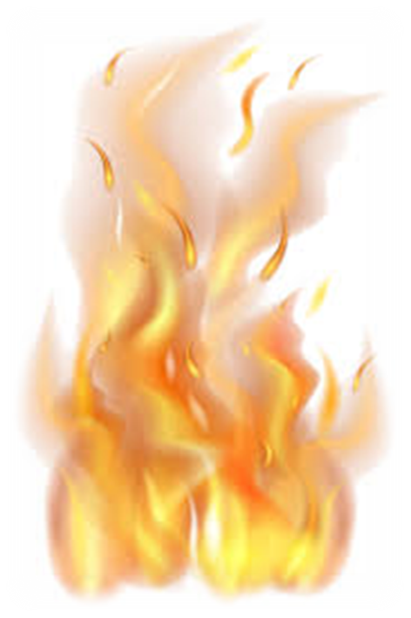
The Facts About Fire

Slide 3
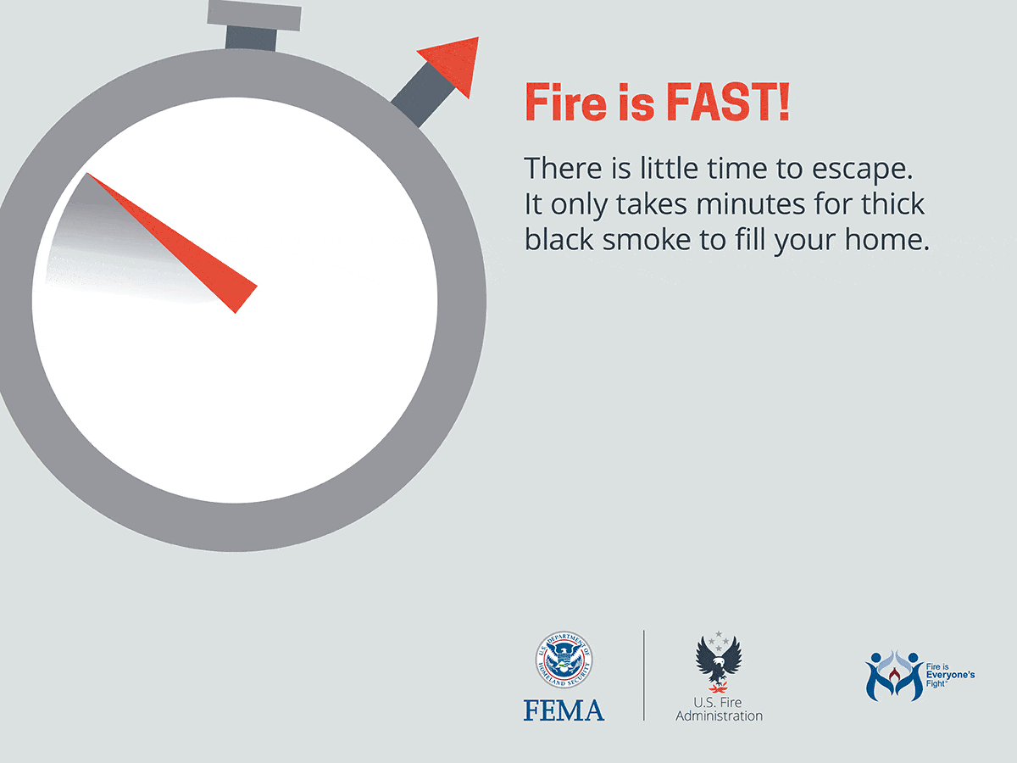
Less than 30 Seconds Small Flame Can Turn Into a Major Fire
It Only Takes Minutes for Thick Black Smoke to Fill a House
A House or Apartment Can Be Engulfed in Flames in Minutes
You Won't Have Time to Grab Valuables
There is Only Time to Escape

Slide 4
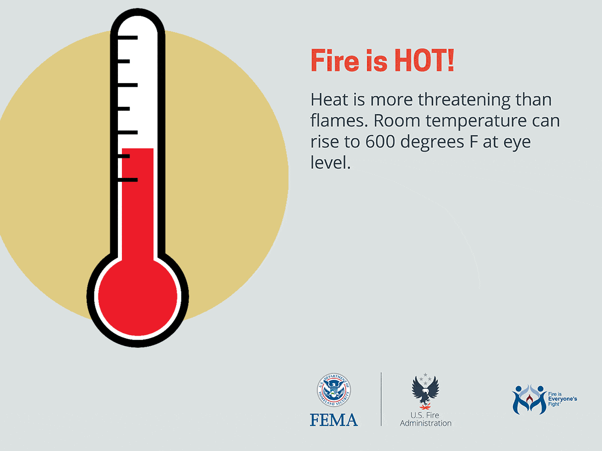
Temperatures can be 100° at floor level & rise to 600° at eye level
Inhaling this super-hot air will scorch your lungs
In five minutes a room can get so hot that everything in it ignites at once: this is called flashover

Slide 5
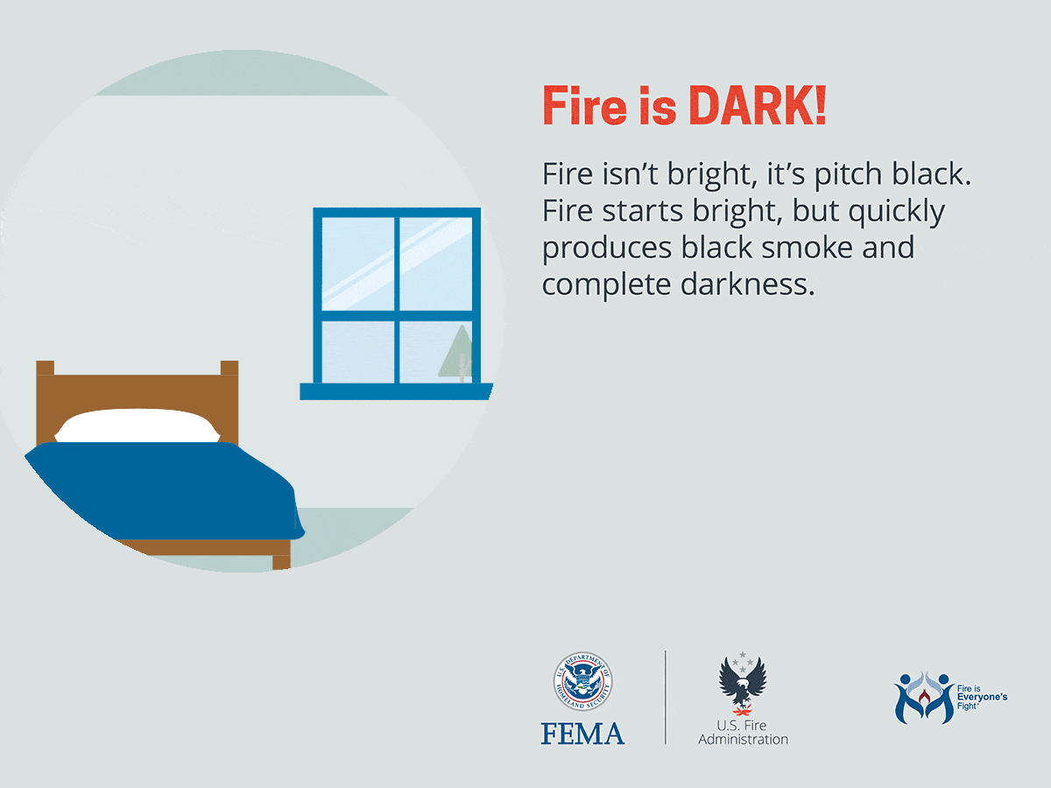

Fire Starts Bright, But Quickly Produces Black Smoke & Complete Darkness
If You Wake Up to a Fire You May Be…
  Blinded
  Disoriented
  Unable to Find Your Way Around the Home You've Lived in for Years

Slide 6
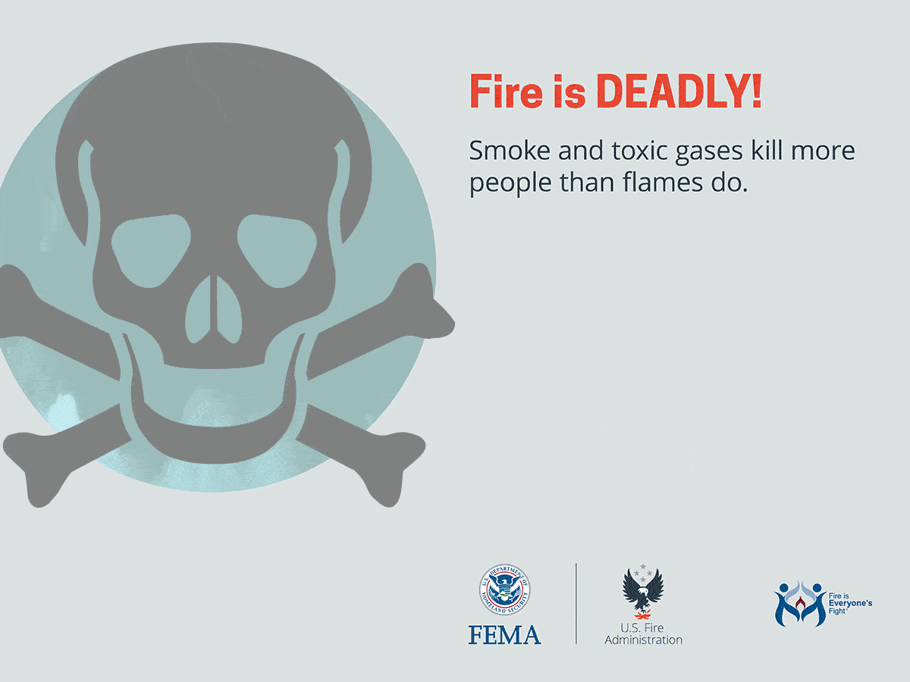
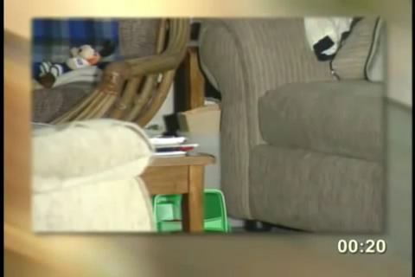
Fire Uses Up Oxygen & Produces Smoke & Poisonous Gases
Breathing Small Amounts Can Make You Drowsy Disoriented & Short of Breath
Odorless/Colorless Smoke Can Disable Before Flames Reach You
You May Not Wake Up in Time to Escape

Slide 7

Bringing it Closer to Home
The Office of the Fire Marshal and Emergency Management

Slide 8
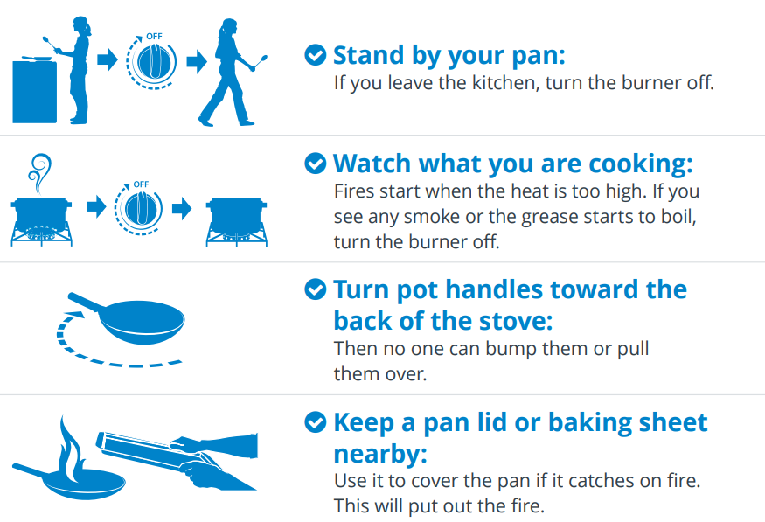
Prevent Kitchen Fires

Slide 9
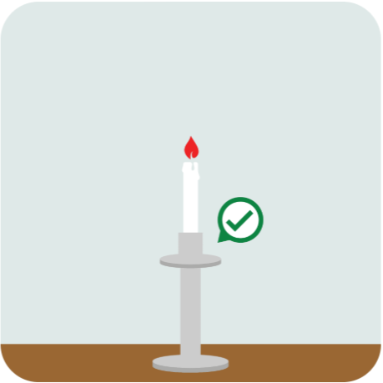
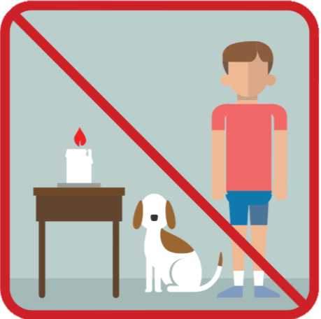
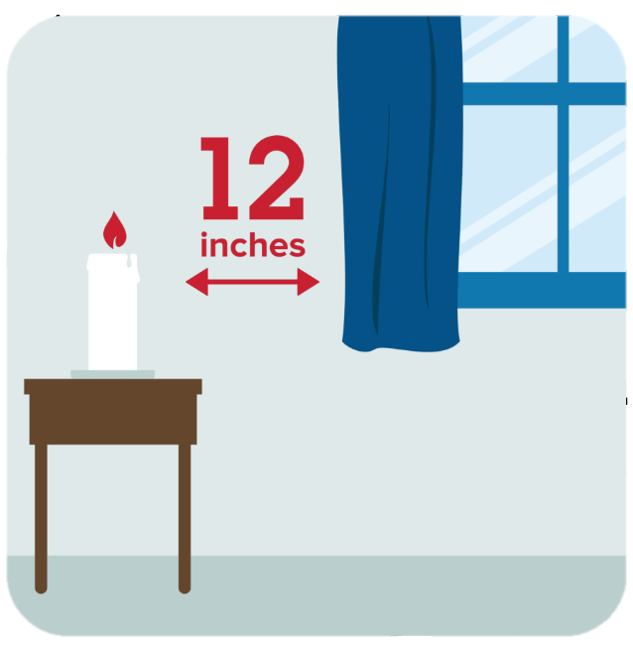
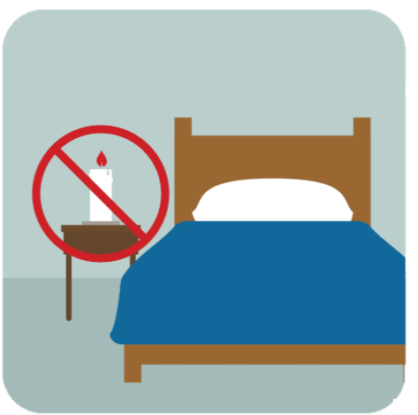
Candle Fire Safety
Put candles in sturdy holders
Make sure candles cannot be reached by children or pets
Place candles at least 12 inches away from anything that can burn
Blow out all candles if you leave the room, get sleepy, or go to bed

Slide 10

Grilling Fire Safety

Slide 11
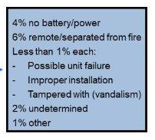
Smoke & Carbon Monoxide Detectors
The Office of the Fire Marshal and Emergency Management

Slide 12
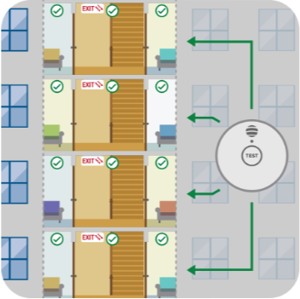
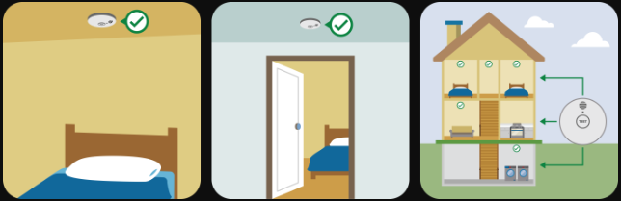
Smoke & Carbon Monoxide Detectors

Slide 13
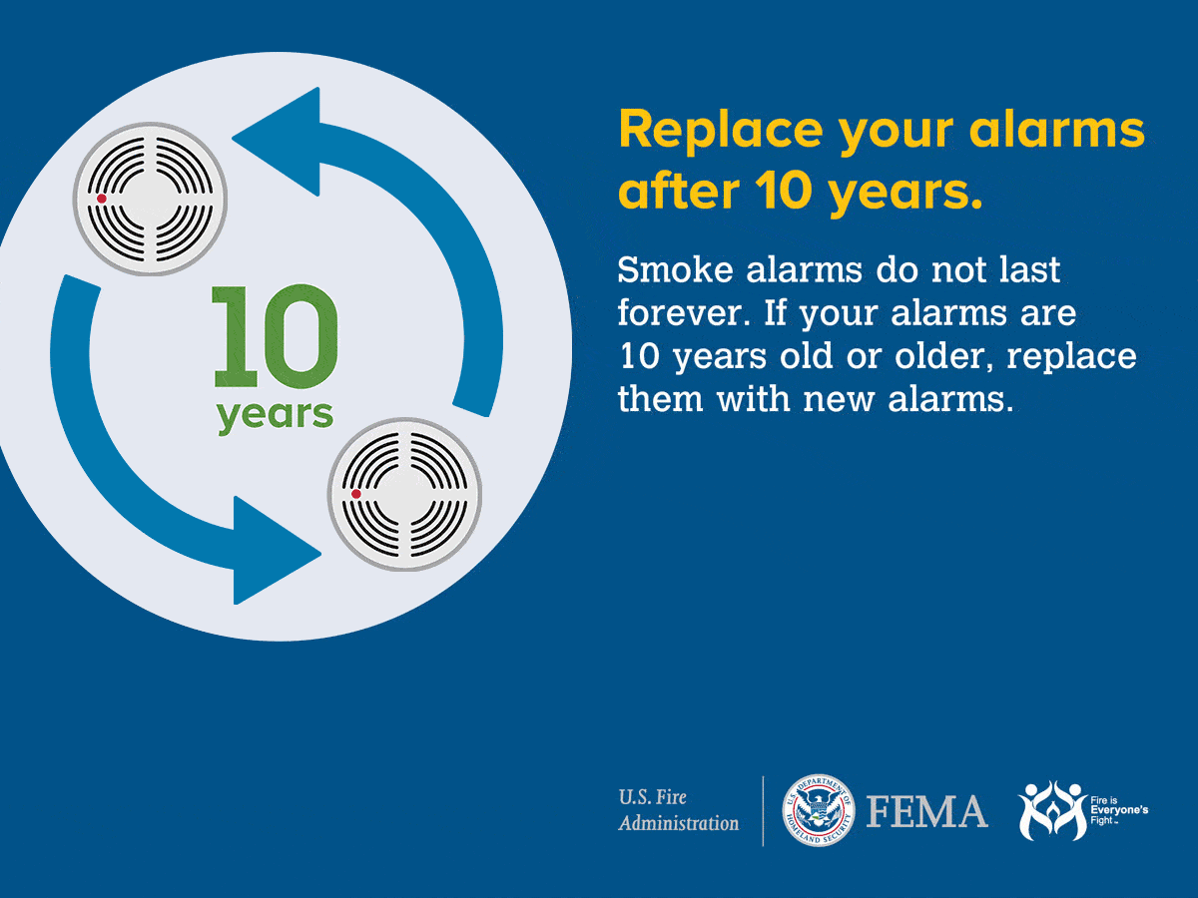
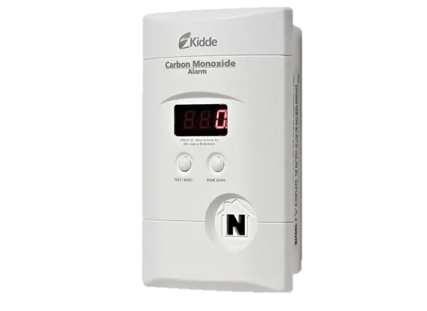
Smoke & Carbon Monoxide Detectors
Carbon Monoxide Alarms… Good for Six to 10 years… Check with the Manufacture

Slide 14
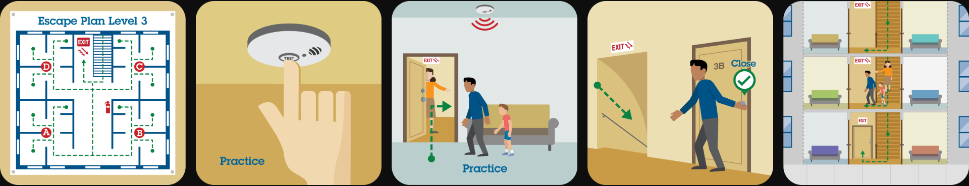
Exit Planning & Fire Drills

